Slide 1
CS461 – RECITATION 03
Machine Learning Principles
Daize Dong
2025-09-30

Slide 2
TODAY’S CONTENT
K-means
Quiz 01

Slide 3
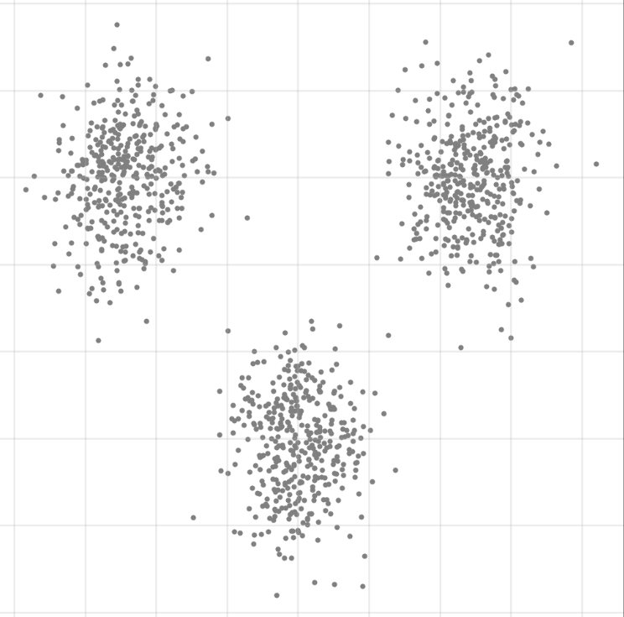
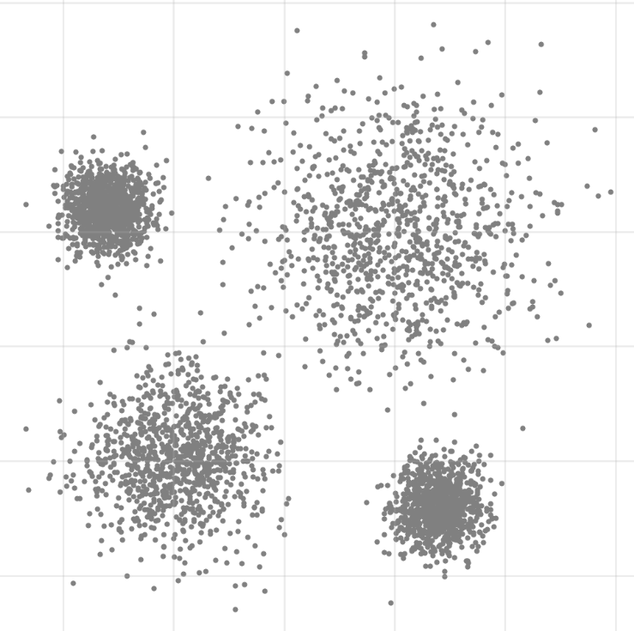
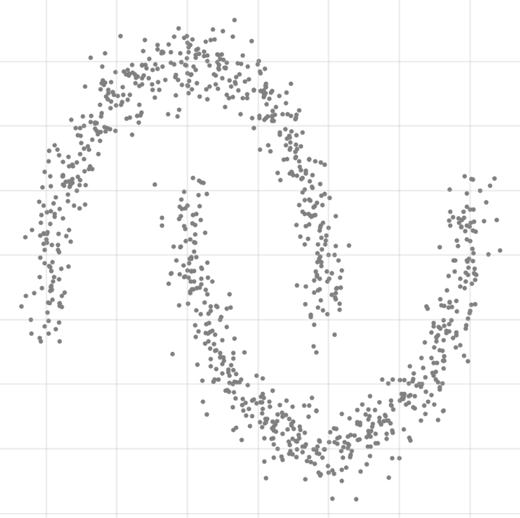
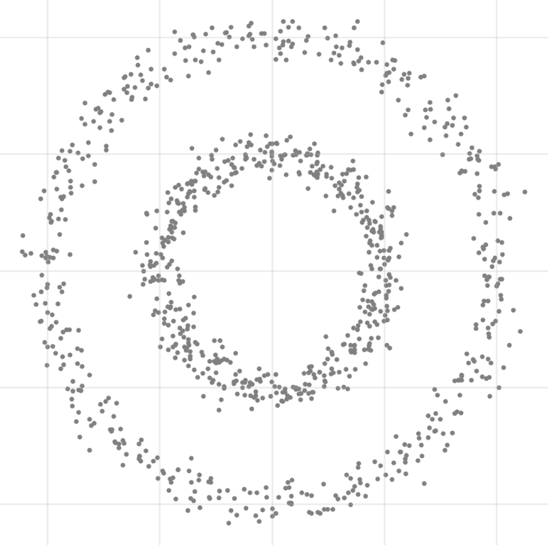
K-means
Blob
Gaussian
Moon
Circle

Slide 4
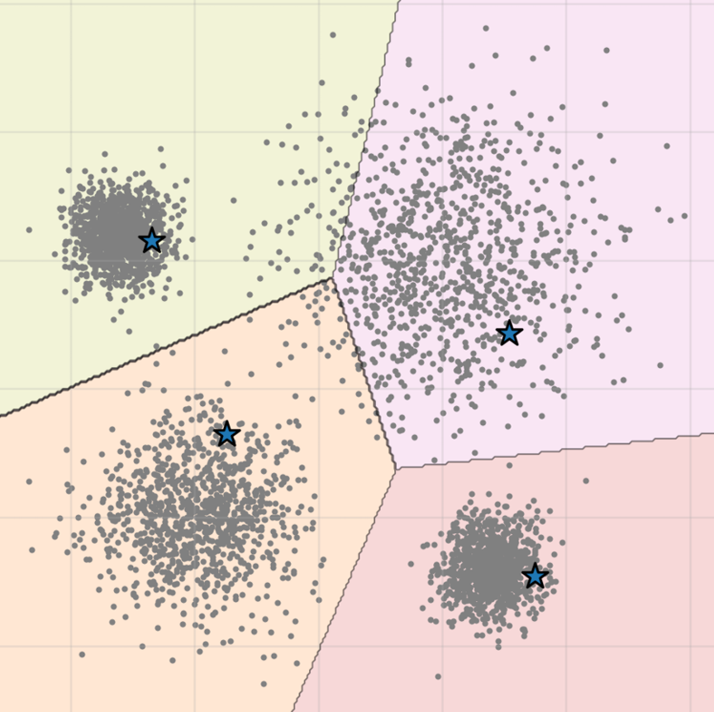
STEP 1:
Initialize centroids
Choose K value and randomly pick K points

Slide 5
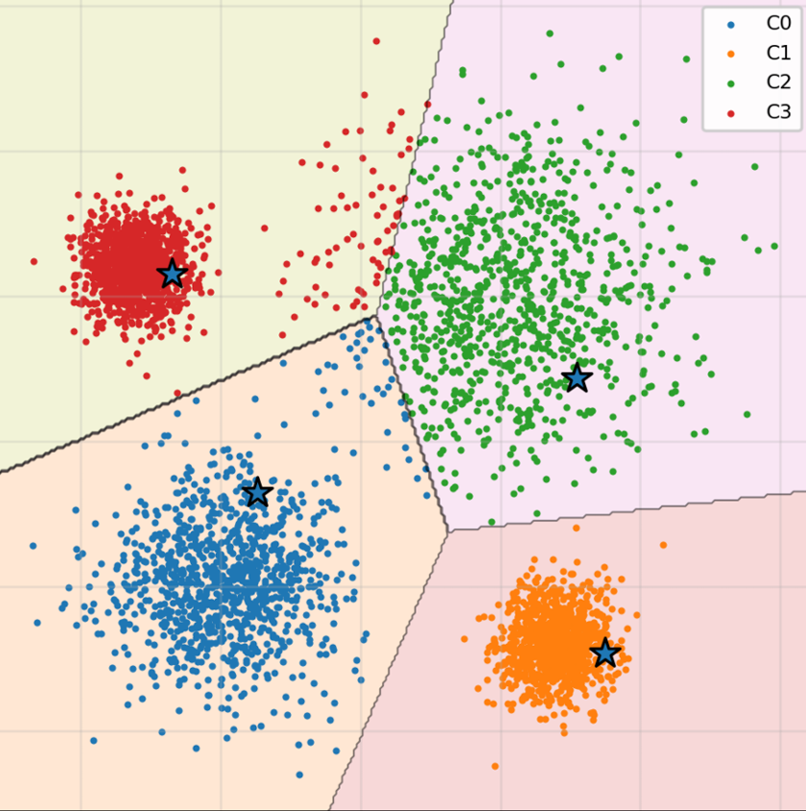
STEP 2:
Assign nearest centroids
Calculate the distance to each centroid for all data

Slide 6
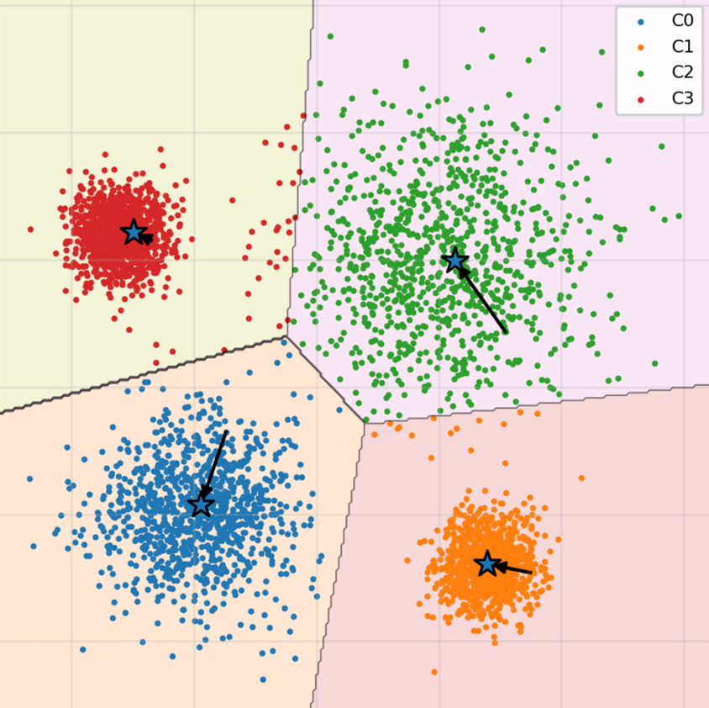
STEP 3:
Get NEW CENTROIDS
New centroid: mean value of all data within the cluster

Slide 7
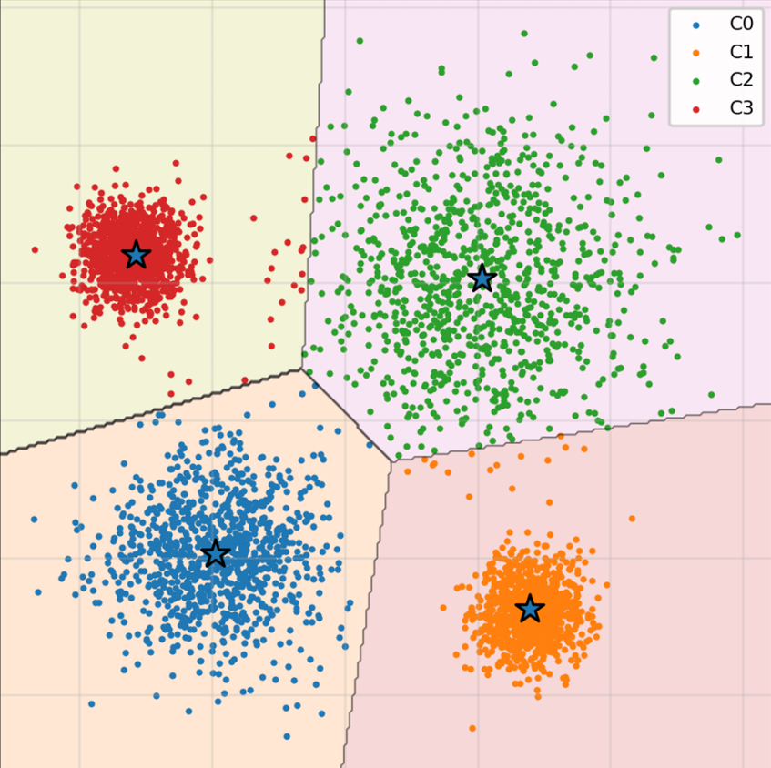
STEP 4:
Repeat until stable
…
Stable: No/Subtle change on each cluster

Slide 8
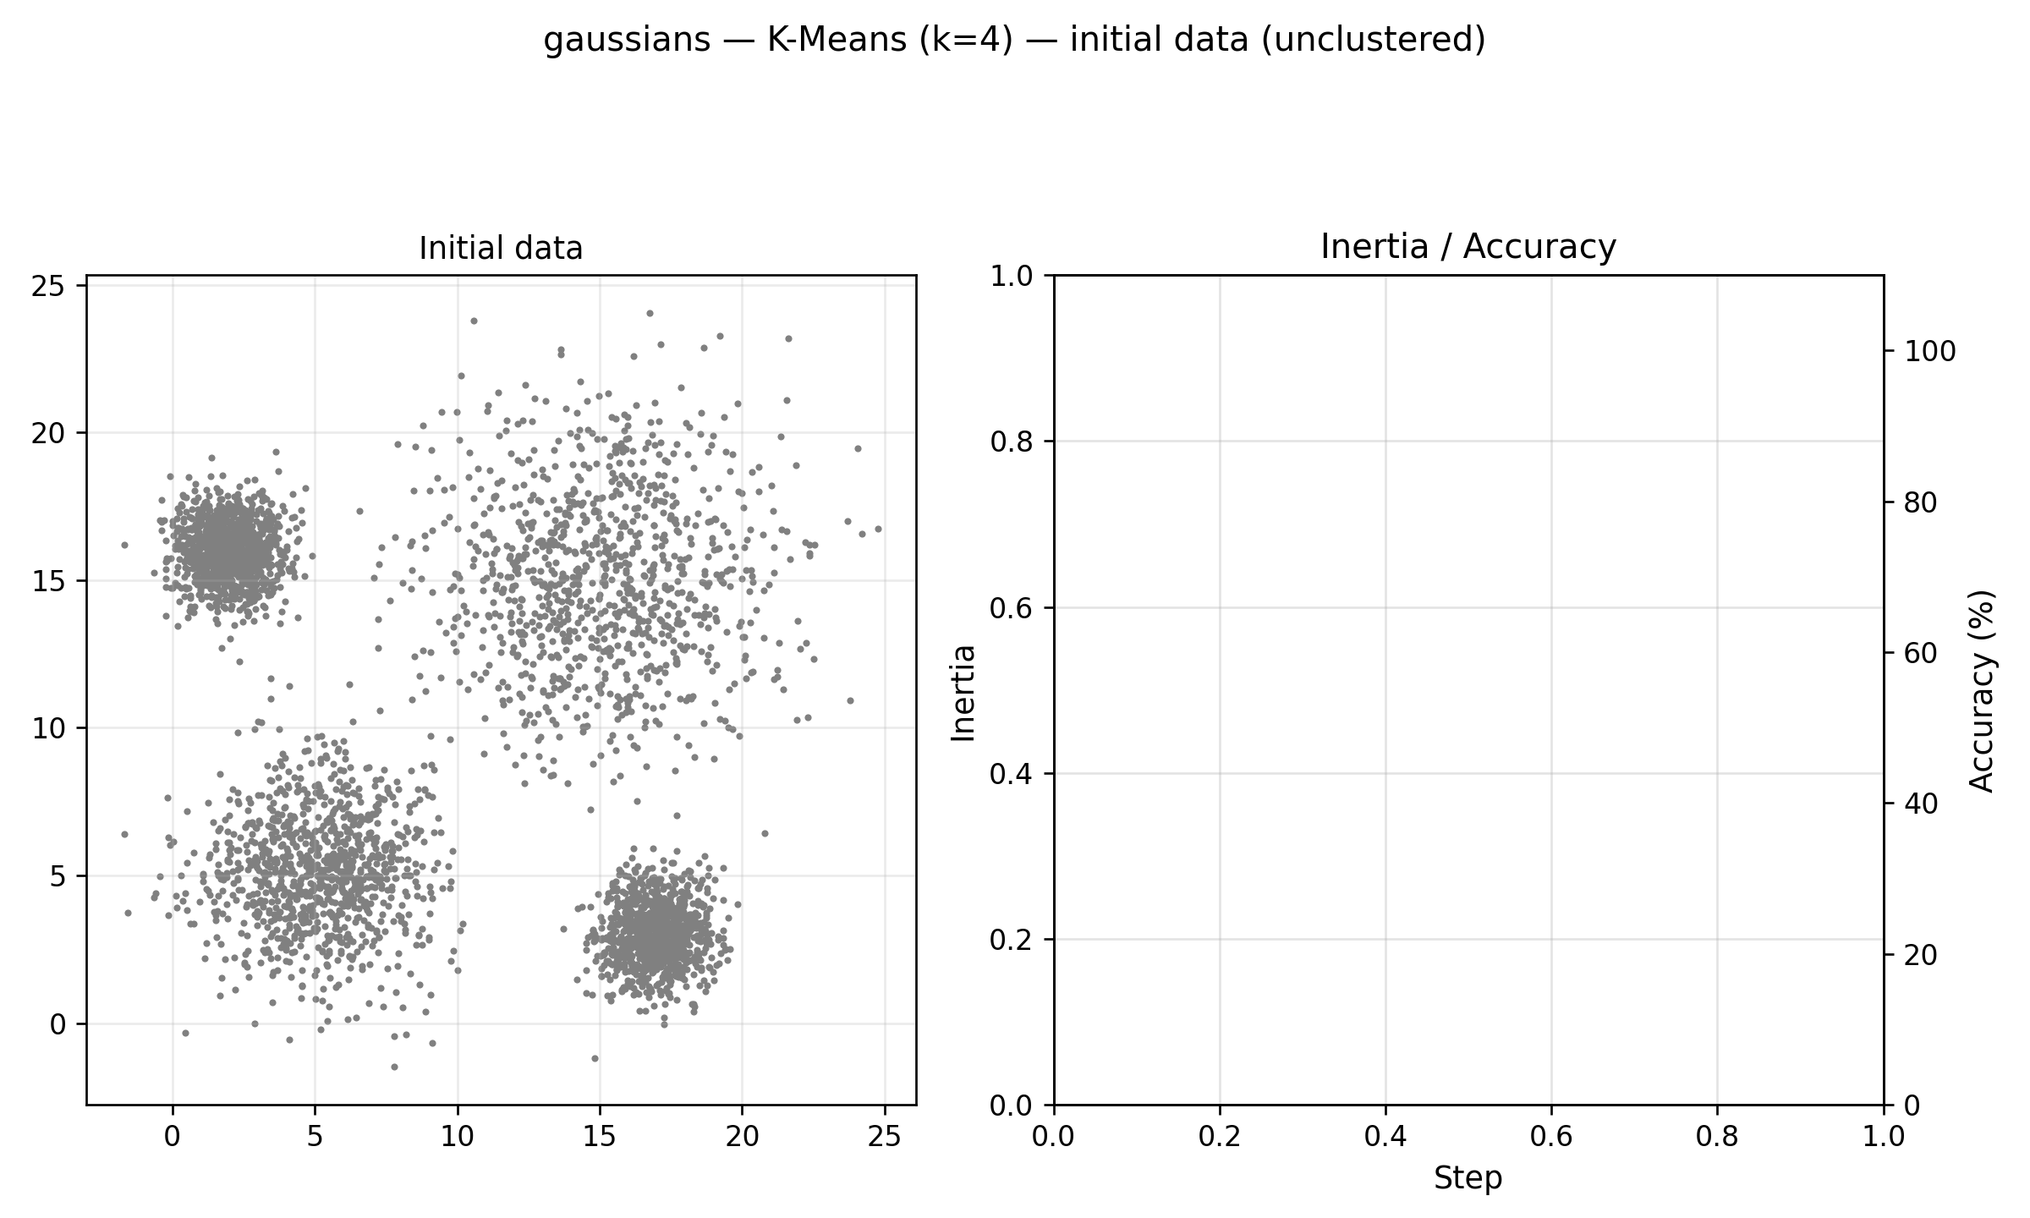
gaussian data
GIF (best view in .pptx)

Slide 9
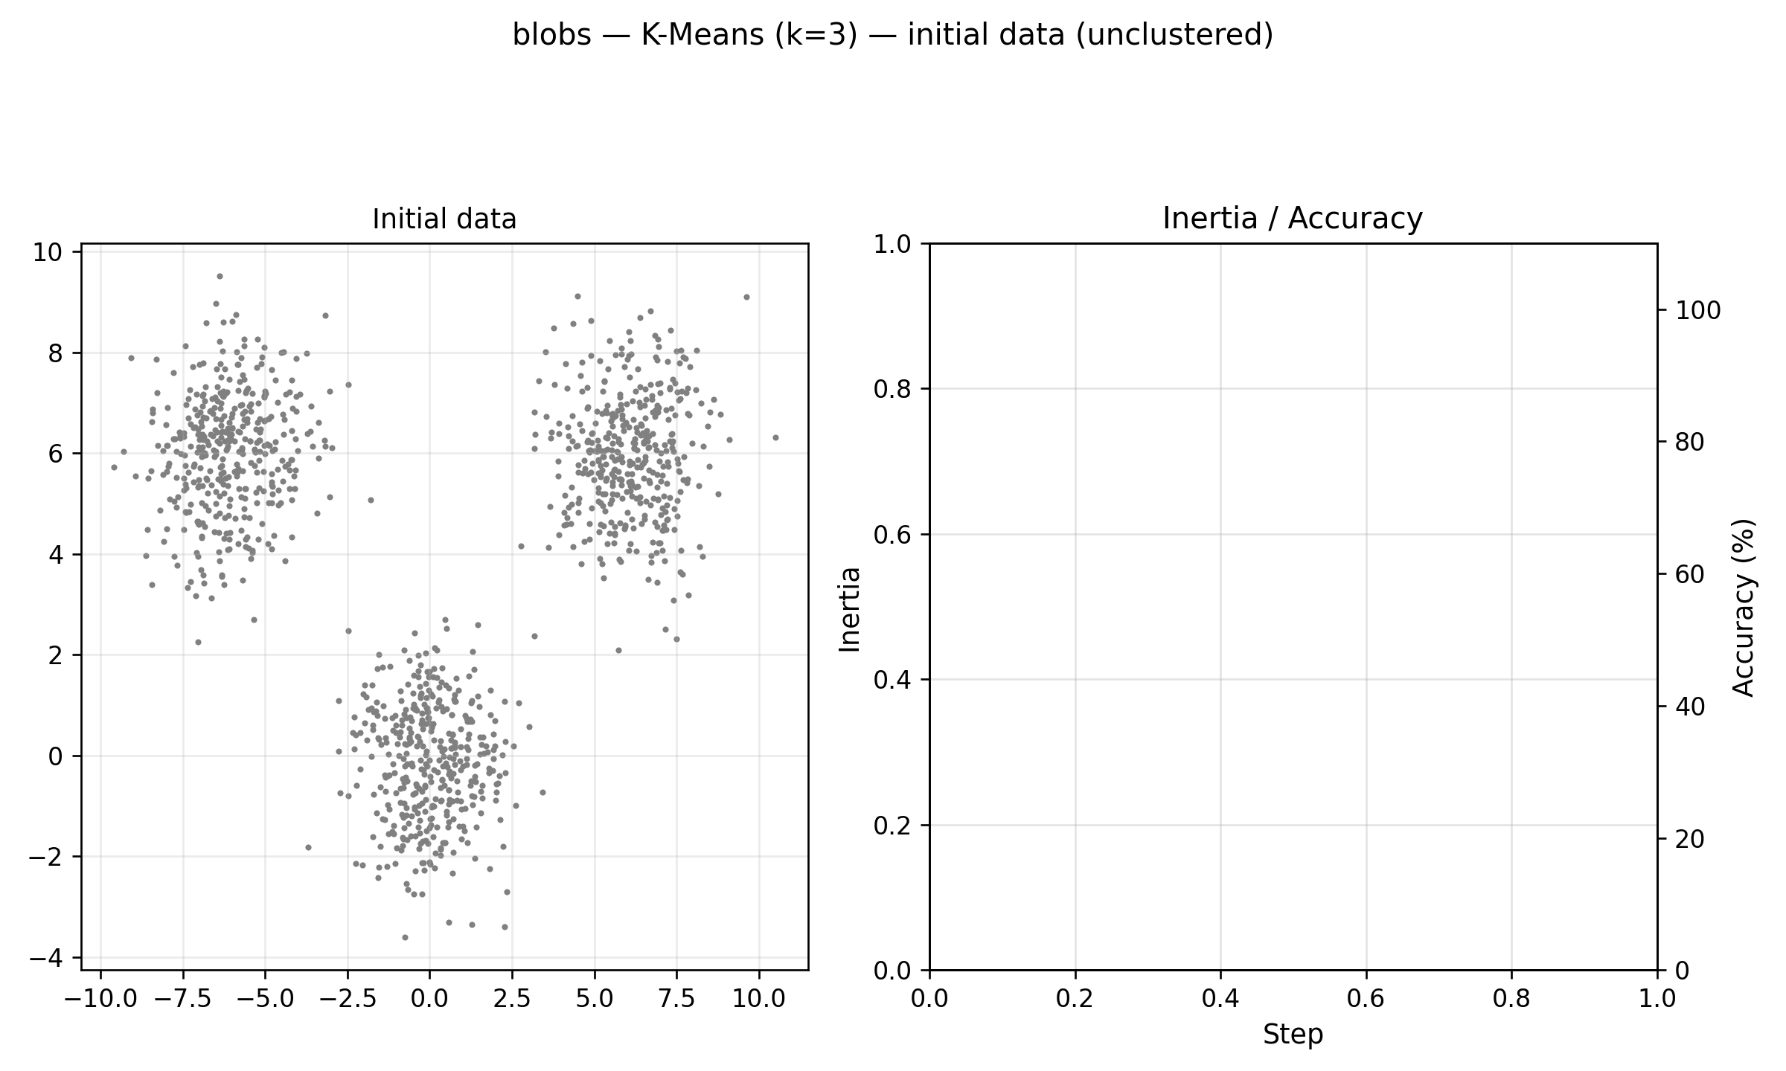
BLOB data
GIF (best view in .pptx)

Slide 10
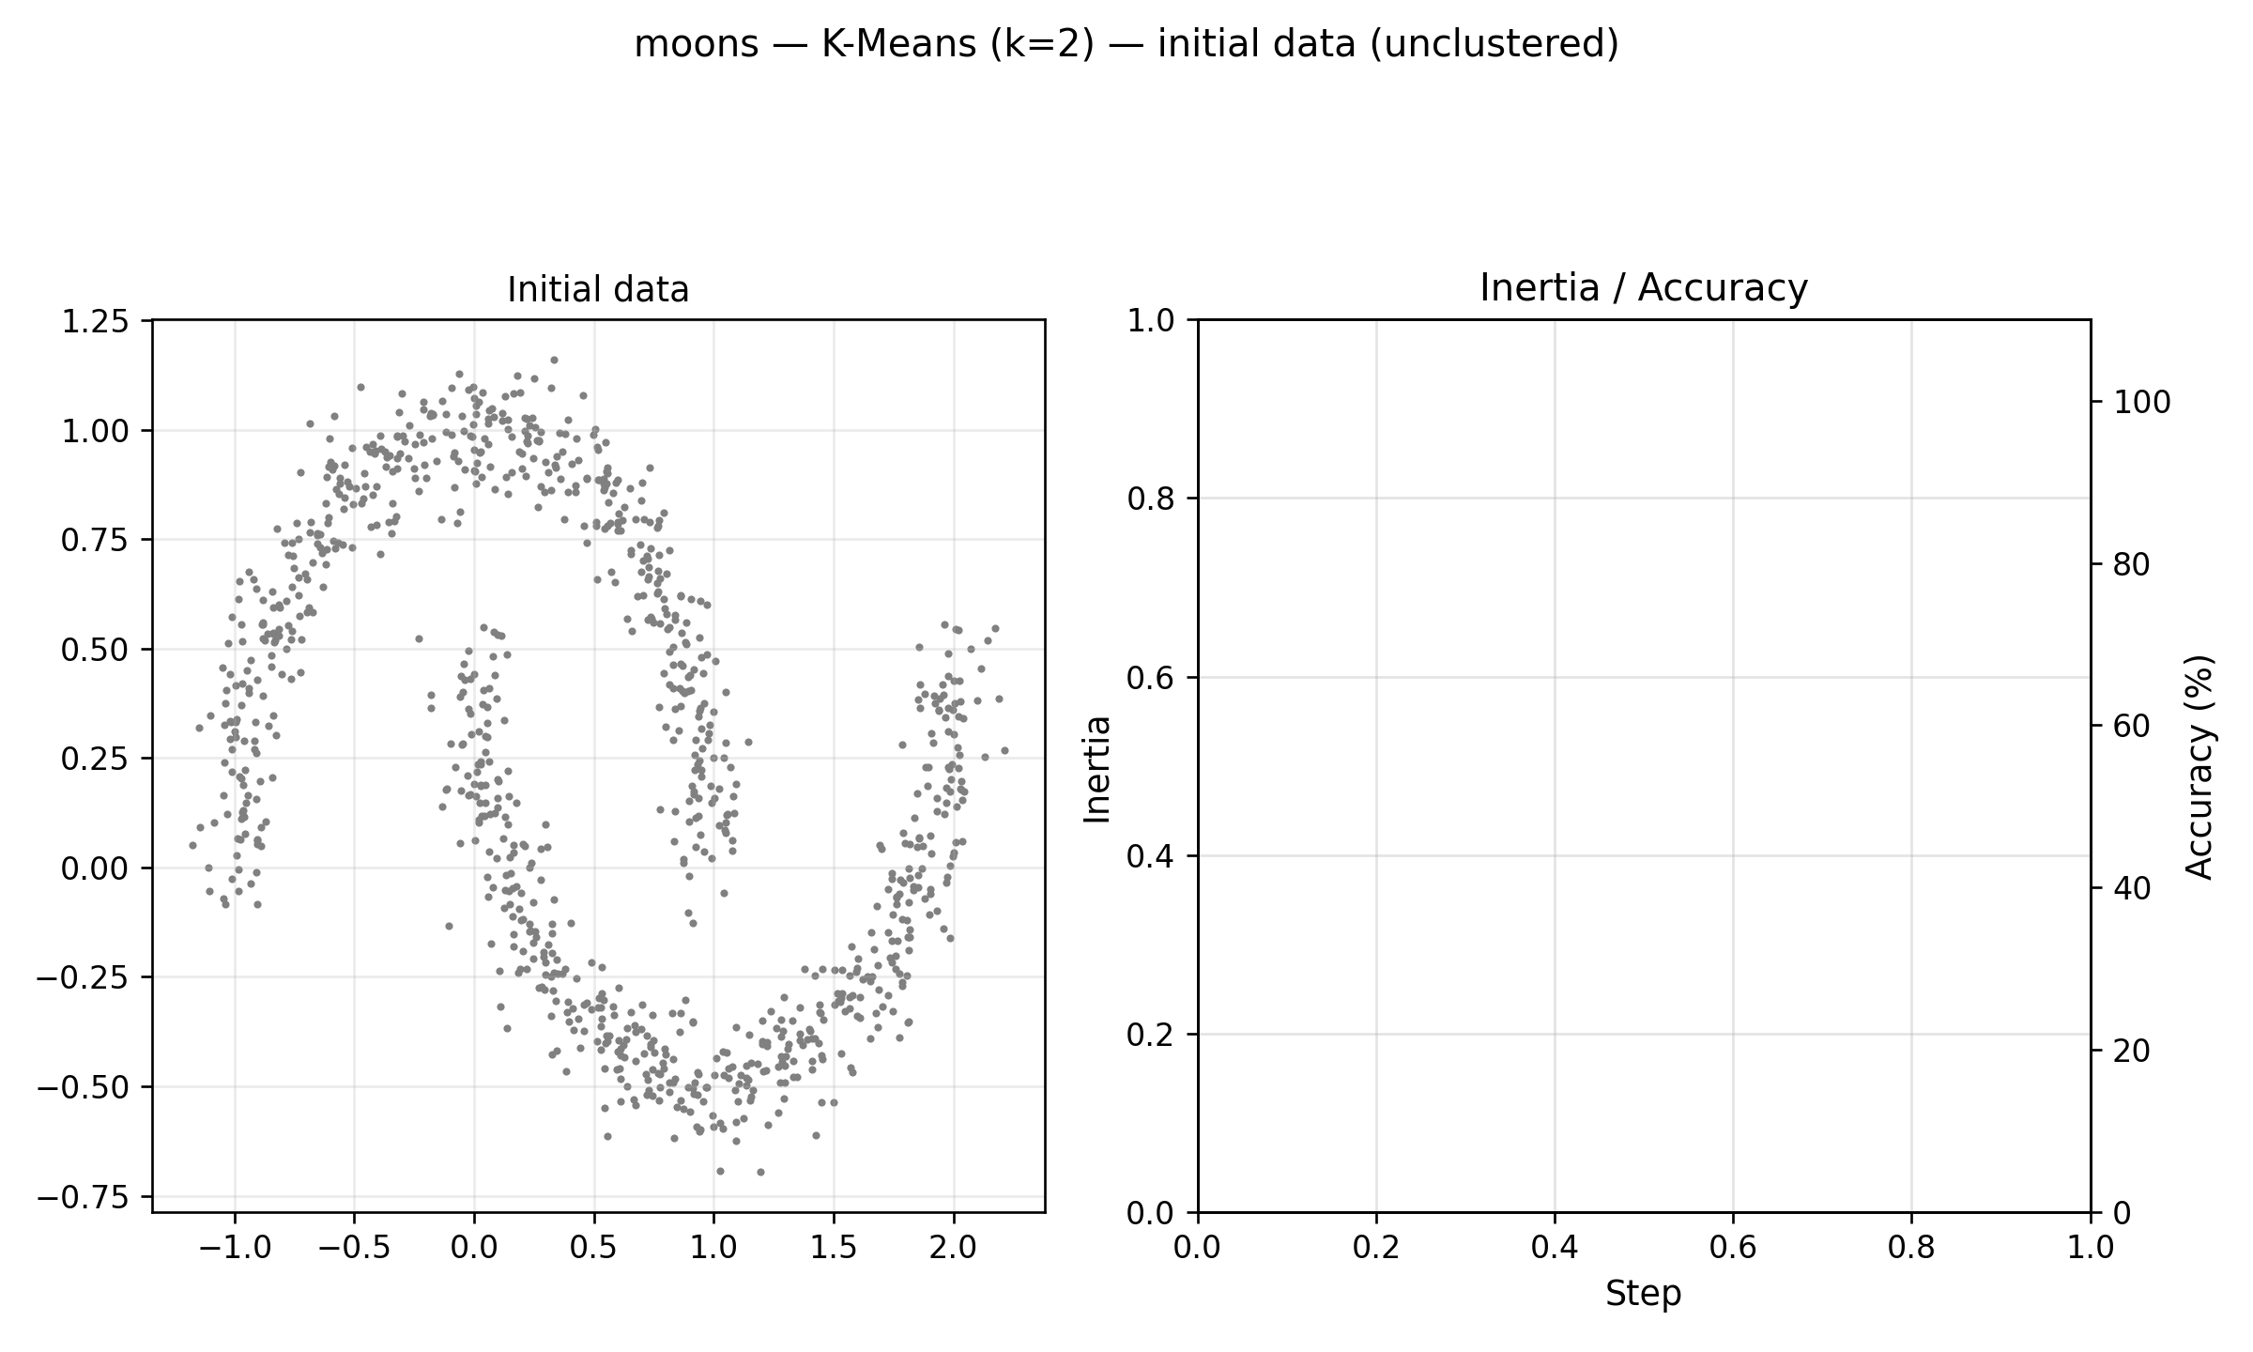
MOON data
GIF (best view in .pptx)

Slide 11
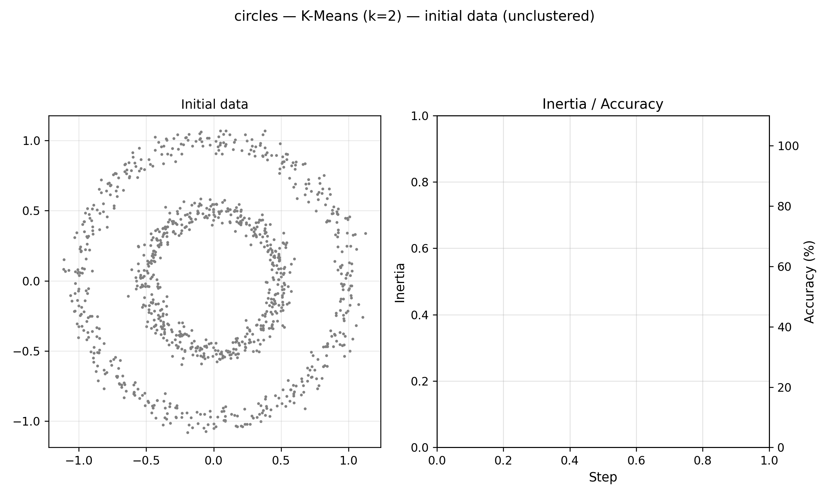
CIRCLE data
GIF (best view in .pptx)

Slide 12
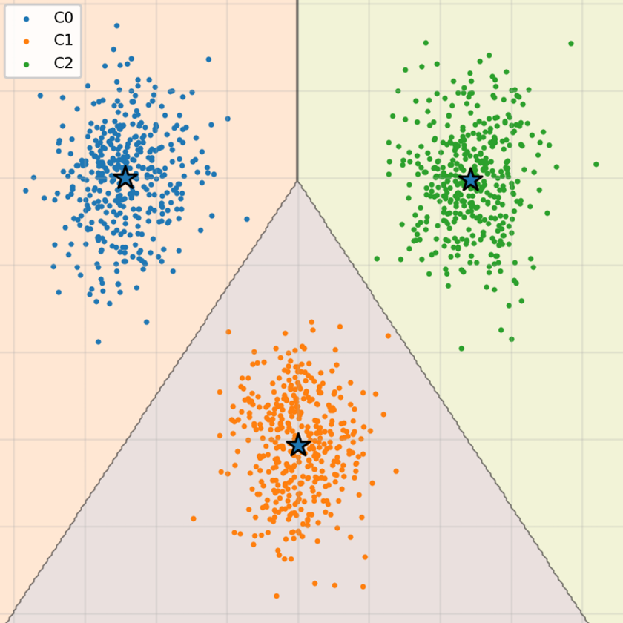
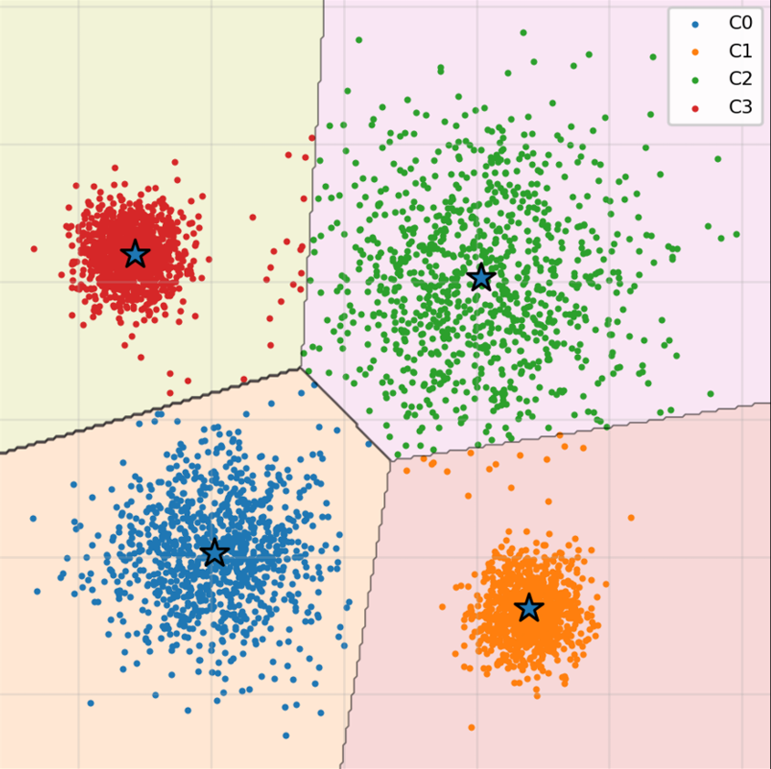
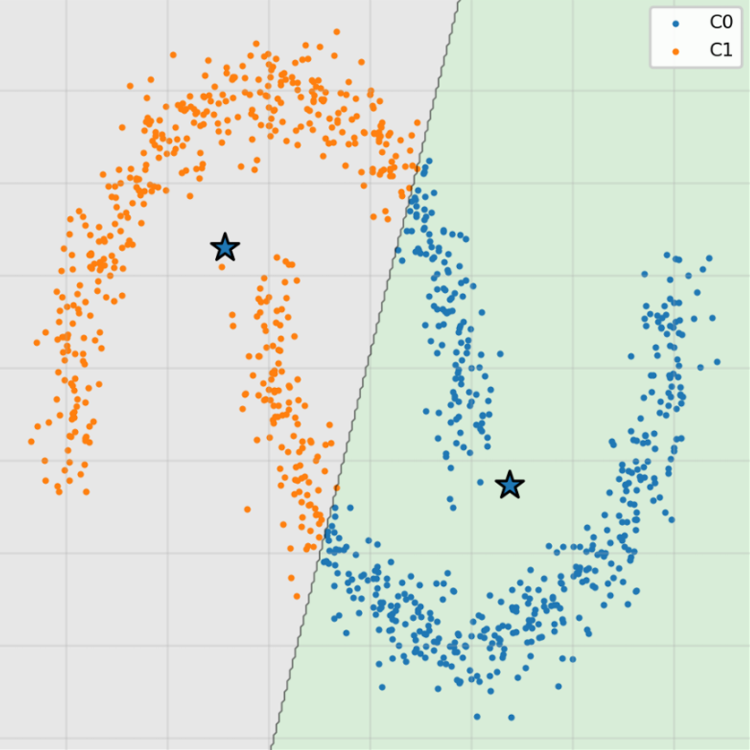
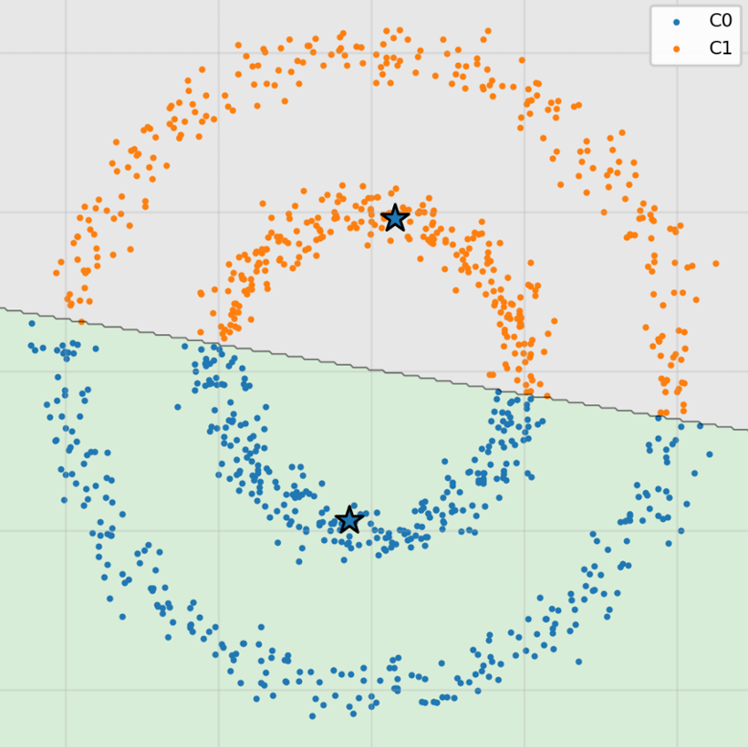
SUMMARY
Blob
100%✅
Gaussian
99%✅
Moon
75%💦
Circle
50%🤡

Slide 13
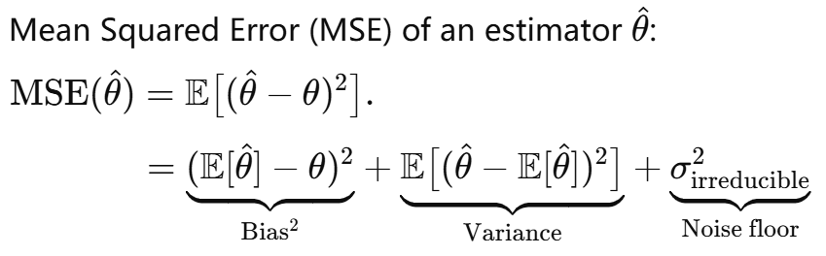
QUIZ 01
A | B | C | D
6 | 0 | 14 | 0
1) Which of the following statements are true?
Unbiased estimators have the lowest error of any estimators.
The sin function is not polynomial so bias cannot be measured.
0 is an unbiased estimator of sin(x)
The sin function exists from −∞ to ∞ so bias cannot be measured.
Biased, regularized estimators can have lower Mean Square Error (MSE).

Slide 14
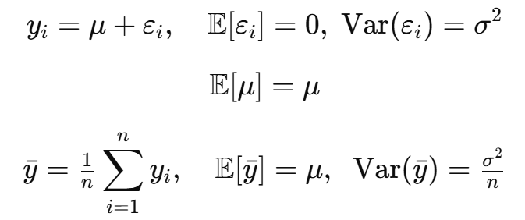
QUIZ 01
A | B | C | D
3 | 10 | 2 | 5
2) As the amount of noise increases, which of the following is false?
More data is required to estimate the signal.
More computationally expensive machine learning techniques are required.
The quality of the signal estimate worsens.
If the noise is i.i.d., then the mean of the samples is still the best estimate of the signal’s mean.
More compute ≠ Lower variance
Sometimes it makes the fitting worse

Slide 15
QUIZ 01
A | B | C | D
10 | 7 | 3 | 0
3) Which of these sentences best describes the bias variance trade-off?
The person modelling should choose a bias-variance trade-off based upon knowledge of the dataset.
A model should capture the variance in a dataset by increasing its complexity and reducing bias to a presumed distribution.
A model should be simplified to bias it to avoid matching the variance of a dataset.
The bias-variance trade-off is inherent to a dataset and is not controlled by the model.
Not all dataset are the same so we need to choose by case
Final goal: lower the error

Slide 16
QUIZ 01
A | B | C | D
0 | 1 | 13 | 6
4) When we modify the normal equation like this, 𝛽 = (𝑋𝑇𝑋 +𝜆𝐼)−1𝑋𝑇𝑦, the 𝜆
is a meaningless constant.
is only there to stabilize the matrix inversion.
shapes the parameters, biasing the model to better match noise of a guassian distribution.
is a heuristic that was invented by Laplace to make Guass’ least squares regression work on non-Guassian data.
Basic concept in ridge regression

Slide 17
QUIZ 01
A | B | C | D
2 | 9 | 7 | 2
5) Which of the following is false about decision boundaries?
For samples on the decision boundary, we expect the probability of belonging to a class to be near 0.5.
Logistic regression will create decision boundaries based upon sample statistics, not prediction error rates.
The perceptron model will create decision boundaries based upon sample statistics, not prediction error rates.
The sigmoid function converts a decision boundary to a probability estimate.
- Logistic regression fits parameters by maximizing likelihood.
Boundary comes from fitted probabilities ($p0=0.4, p1=0.6$), not directly from minimizing classification errors.
- The perceptron model only looks at the prediction error (-1 or 1), and not at sample statistics.

Slide 18
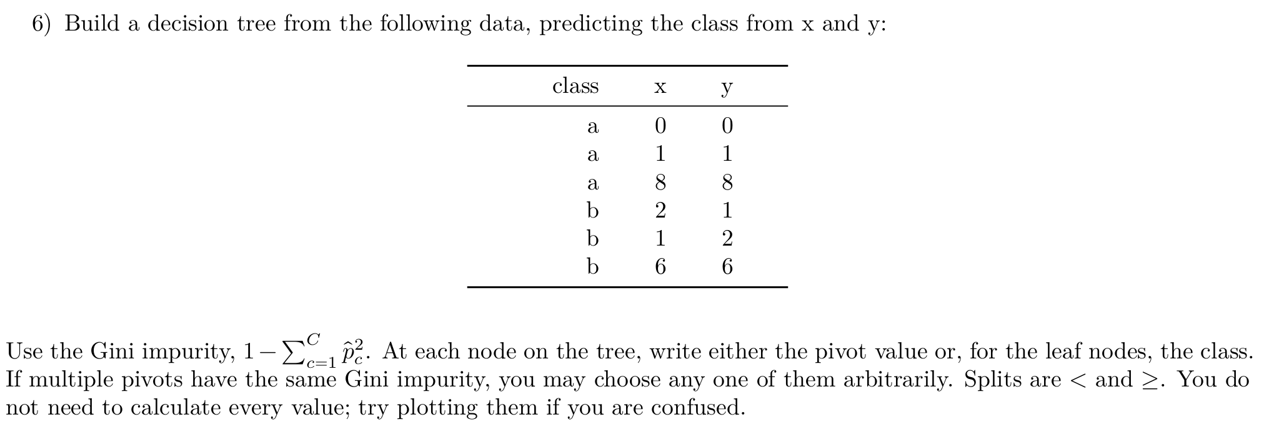
QUIZ 01

Slide 19
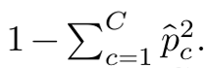
QUIZ 01
def gini_impurity(classlist):
......
# Calculate the geni impurity for a single set
classes, counts = np.unique(classlist, return_counts=True)
p_hats = counts / len(classlist)
gini = 1.0 - np.sum(p_hats ** 2)
return np.sqrt(gini)
def get_best_impurity(column, classlist, comparison_left, comparison_right):
......
# The weighted gini impurity of both sides
left_impurity = gini_impurity([classlist[index] for index in left_indices])
right_impurity = gini_impurity([classlist[index] for index in right_indices])
weighted_impurity = (len(left_indices) / len(classlist)) * left_impurity + \
(len(right_indices) / len(classlist)) * right_impurity
......
Gini Impurity:
This decides the split point for attributes!

Slide 20
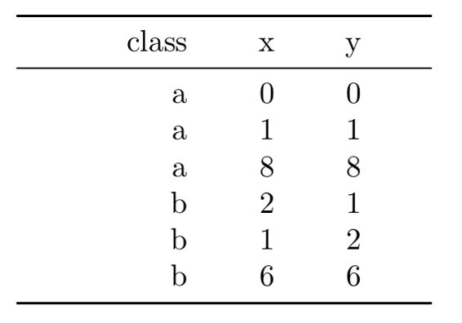
QUIZ 01
?
X
a ab b b a
0 1 2 6 8
Initialize points:
Y
a ab b b a
0 1 2 6 8

Slide 21
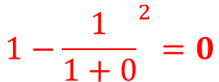

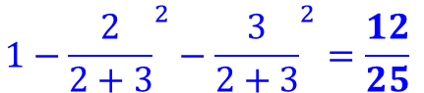
QUIZ 01
?
a: 1
b: 0
a: 2
b: 3
X
a ab b b a
0 1 2 6 8
Single gini impurity:
$$1−{\frac{1}{1+0}}^{2}=0$$
$$1−{\frac{2}{2+3}}^{2}−{\frac{3}{2+3}}^{2}=\frac{12}{25}$$
Weighted gini impurity:
$$\frac{1}{6} ×0+\frac{5}{6}×\frac{12}{25}=\frac{2}{5}$$

Slide 22
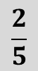
QUIZ 01
?
a: 1
b: 0
a: 2
b: 3
$$\frac{2}{5}$$
X
a ab b b a
0 1 2 6 8
Weighted gini impurity:
$$\frac{1}{6} ×0+\frac{5}{6}×\frac{12}{25}=\frac{2}{5}$$

Slide 23

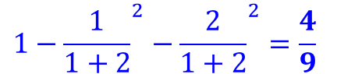
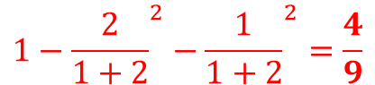
QUIZ 01
?
a: 2
b: 1
a: 1
b: 2
$$\frac{2}{5}$$
X
a ab b b a
0 1 2 6 8
Continue with others:
$$1−{\frac{2}{1+2}}^{2}−{\frac{1}{1+2}}^{2}=\frac{4}{9}$$
$$1−{\frac{1}{1+2}}^{2}−{\frac{2}{1+2}}^{2}=\frac{4}{9}$$
$$\frac{3}{6} ×\frac{4}{9}+\frac{3}{6}×\frac{4}{9}=\frac{4}{9}$$

Slide 24
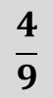
QUIZ 01
?
a: 2
b: 1
a: 1
b: 2
$$\frac{2}{5}$$
$$\frac{4}{9}$$
X
a ab b b a
0 1 2 6 8
Continue with others:
$$\frac{3}{6} ×\frac{4}{9}+\frac{3}{6}×\frac{4}{9}=\frac{4}{9}$$

Slide 25
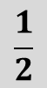

QUIZ 01
?
a: 2
b: 2
a: 1
b: 1
$$\frac{2}{5}$$
$$\frac{4}{9}$$
$$\frac{1}{2}$$
X
a ab b b a
0 1 2 6 8
Keep going on:
$$\frac{4}{6} ×\frac{1}{2}+\frac{2}{6}×\frac{1}{2}=\frac{1}{2}$$

Slide 26
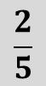

QUIZ 01
?
a: 2
b: 3
a: 1
b: 0
$$\frac{2}{5}$$
$$\frac{4}{9}$$
$$\frac{1}{2}$$
$$\frac{2}{5}$$
X
a ab b b a
0 1 2 6 8
Keep going on:
$$\frac{5}{6} ×\frac{12}{25}+\frac{1}{6}×0=\frac{2}{5}$$

Slide 27
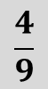
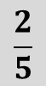
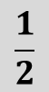

QUIZ 01
?
$$\frac{2}{5}$$
$$\frac{4}{9}$$
$$\frac{1}{2}$$
$$\frac{2}{5}$$
X
a ab b b a
0 1 2 6 8
$$\frac{2}{5}$$
$$\frac{4}{9}$$
$$\frac{1}{2}$$
$$\frac{2}{5}$$
The same for Y!
Y
a ab b b a
0 1 2 6 8

Slide 28




QUIZ 01
?
$$\frac{2}{5}$$
$$\frac{4}{9}$$
$$\frac{1}{2}$$
$$\frac{2}{5}$$
X
a ab b b a
0 1 2 6 8
We use this for example
Choose one with the lowest value:
$$\frac{2}{5}$$
$$\frac{4}{9}$$
$$\frac{1}{2}$$
$$\frac{2}{5}$$
Y
a ab b b a
0 1 2 6 8

Slide 29
QUIZ 01
X,1
X<1
X≥1
a
?
X
a ab b b a
0 1 2 6 8
Split the data:
Y
a ab b b a
0 1 2 6 8

Slide 30
QUIZ 01
X,1
X<1
X≥1
a
X,8
X<8
X≥8
?
a
X
a ab b b a
Repeat until done:
0 1 2 6 8
Y
a ab b b a
0 1 2 6 8

Slide 31
QUIZ 01
X,1
X<1
X≥1
a
X,8
X<8
X≥8
Y,2
a
Y<2
Y≥2
?
b
Repeat until done:

Slide 32
QUIZ 01
X,1
X<1
X≥1
a
X,8
X<8
X≥8
Y,2
a
Y<2
Y≥2
An example answer:
(not the only one)
X,2
b
X<2
X≥2
a
b

Slide 33
Q&A

